Slide 1


Biz & Tech partnership towards …
10 "No Fear Releases" per day
A transformation journey...

Slide 2

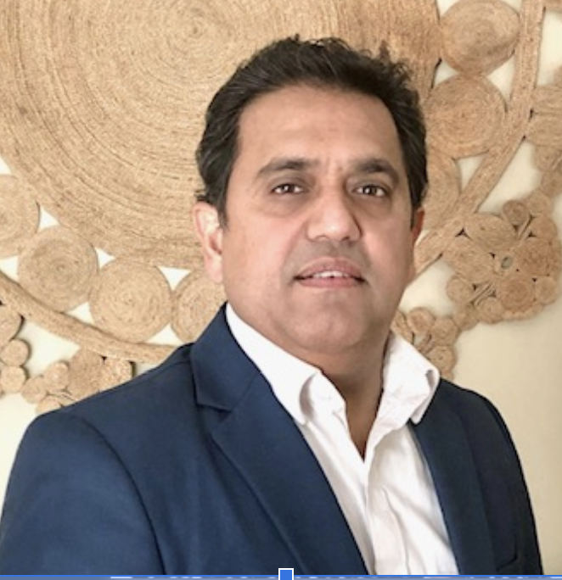


Biswanath Basu
Rakesh Goyal
Jennifer Hansen

Slide 3



20 YEARS ON THE F-500 LIST
25
YEARS OLD
Top 10
DEVOPS LEADERS
MILLIONS OF ACCOUNTS
10,000+ ENGINEERS
ONE OF THE LARGEST DIGITAL BANKS

Slide 4

Agile & DevOps Transformation
Waterfall => Agile
Outsource => Insource & Open source
Monolithic => Microservices
Data Center => Cloud

Slide 5

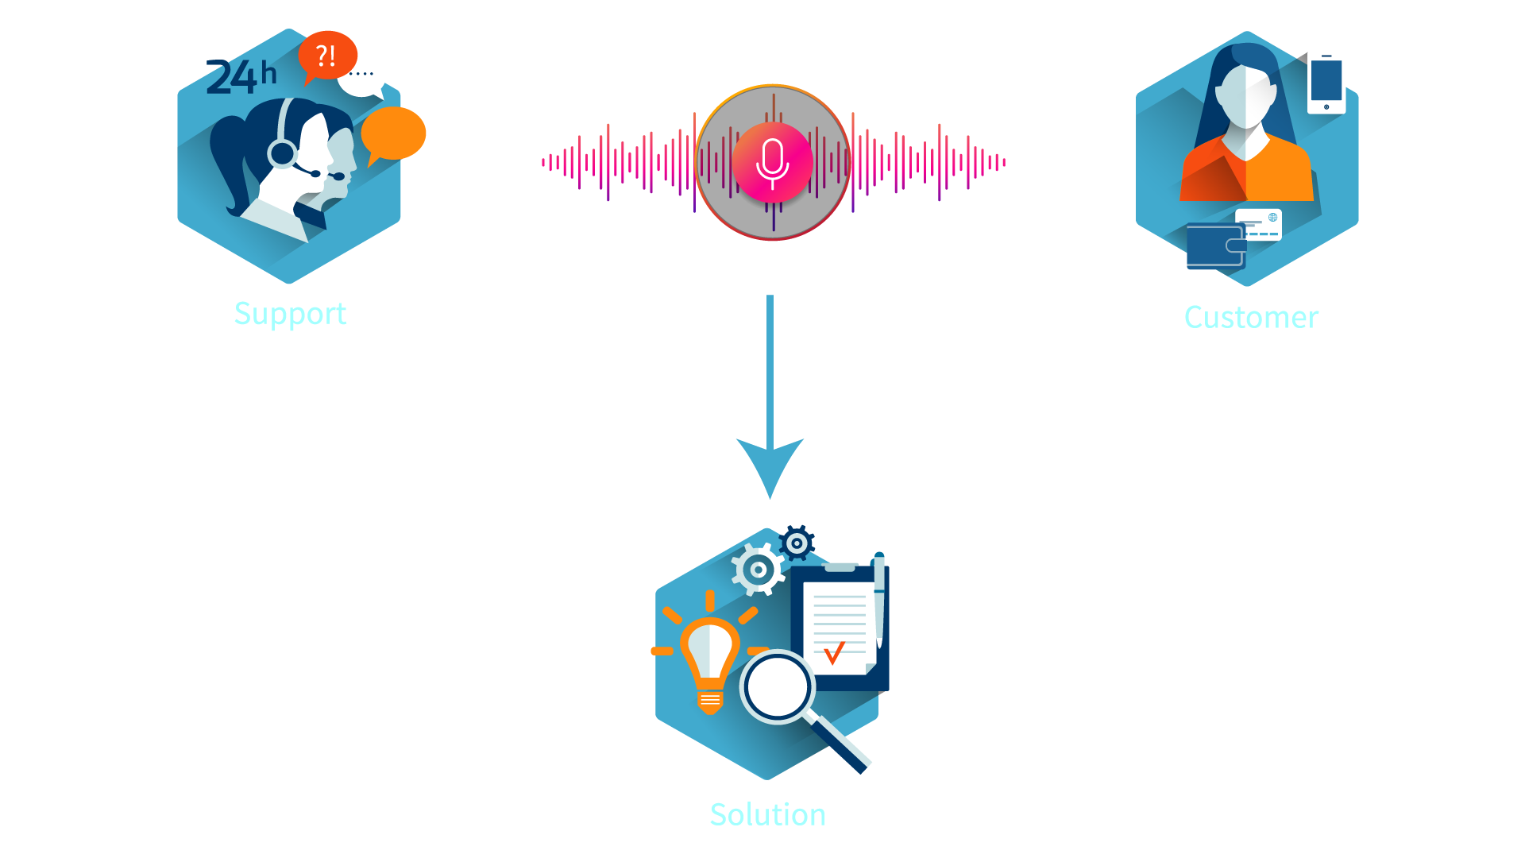
Change Banking for Good!

Slide 6
Core Customer Servicing Platform
Servicing tens of millions of customers generating ‘100’s of millions in bottom-line value

Slide 7
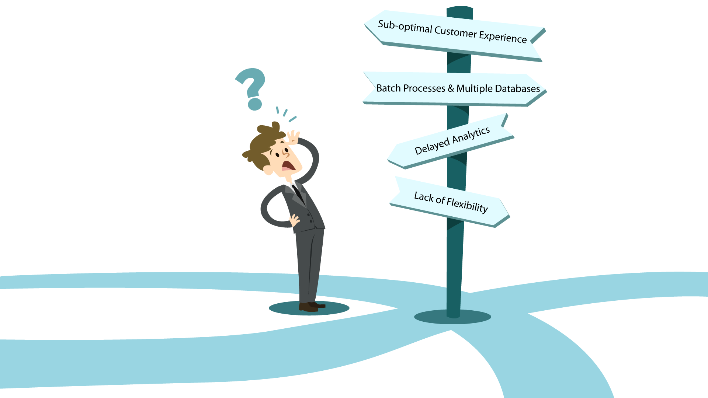
Project Objectives

Slide 8
Key Guiding Principles
Work backwards from customer needs
Maximize Learnings & Minimize Risk
Be vigilant about anchoring bias

Slide 9


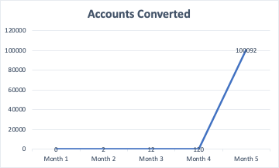
A risk based approach was needed
Segment populations based on customer needs
Deliver a minimum viable experience (MVE) on ‘thin-slices’
Learn quickly, iterate and Scale-up

Slide 10


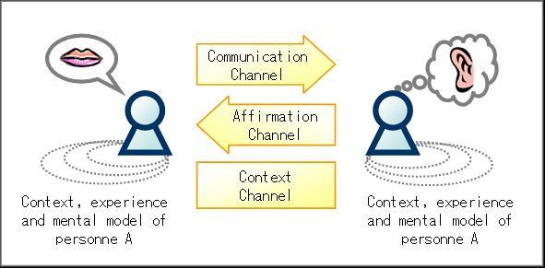


Customer needs always at the core
Customers
Analysts
Regulators
Agents

Slide 11


The problem was challenging
WHAT WE HAD
WHAT WE NEEDED

Slide 12
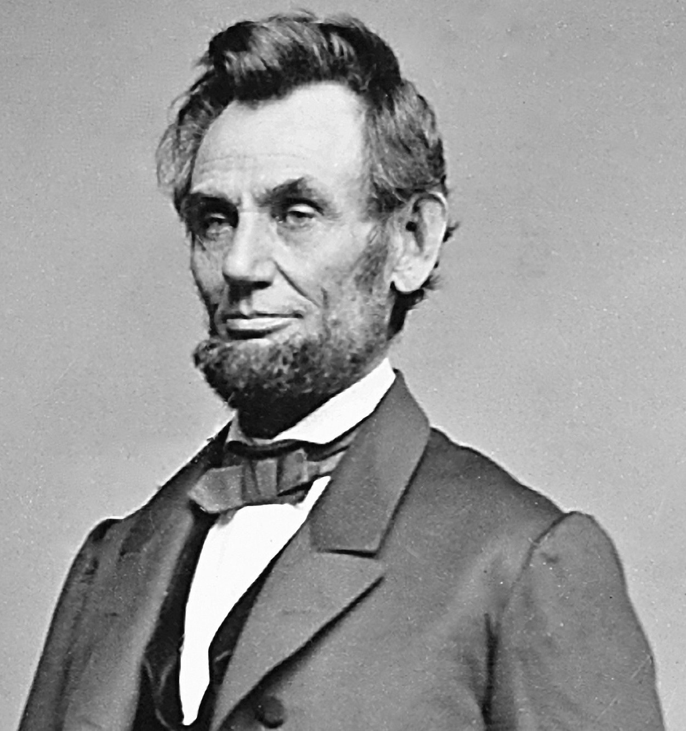
If I only had an hour to chop down a tree, I would spend the first 45 minutes sharpening my axe

Slide 13


Engineering approach
A Cloud-based, API driven, microservices architecture
Upfront engineering & tooling investment was needed
Building out the CI /CD Pipeline to enable incremental releases

Slide 14



Geographically dispersed teams
Initially 6 teams
Grew quickly to 25+ teams
500+ Call center agents

Slide 15
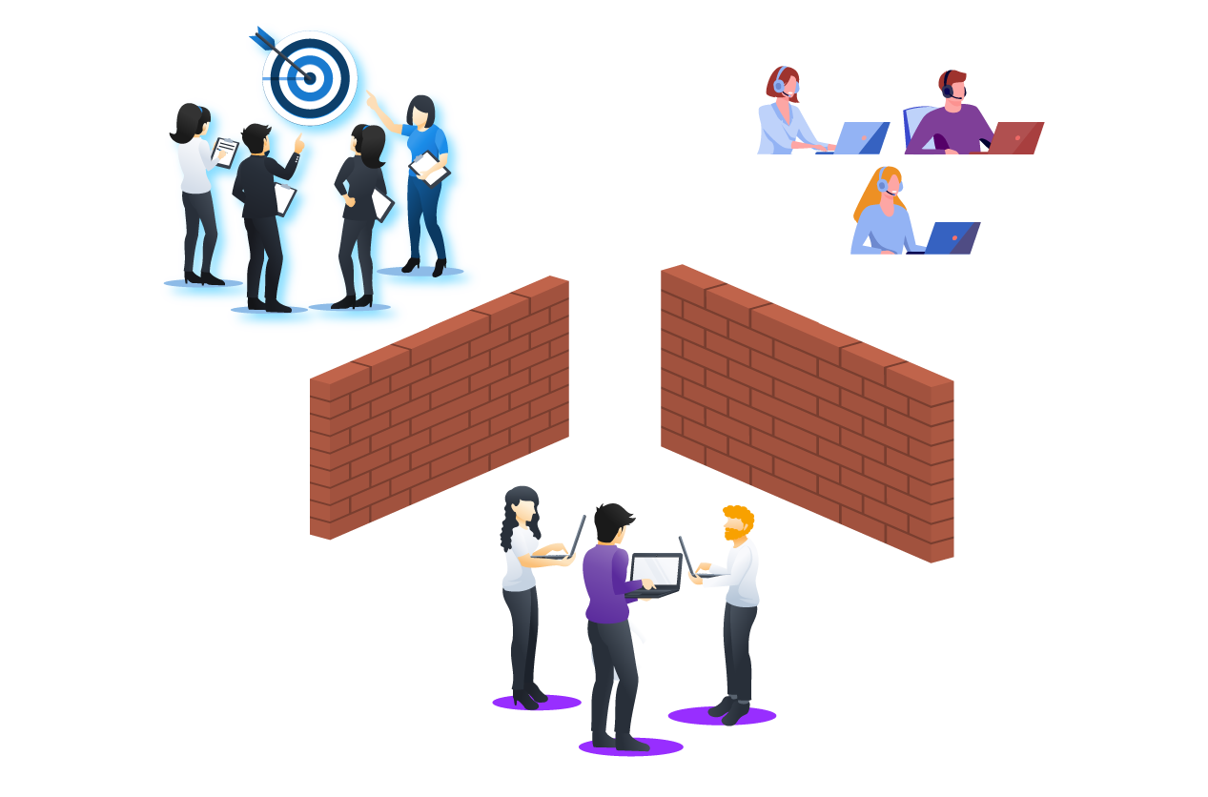
Feature Development
Vendor product updates non-existent, sub-optimal costly workarounds
Multiple manual hand offs between product, eng. and customer servicing
How we worked in the past

Slide 16

Co-location Approach
Product & Development work together as one team
Going beyond: Travel to agents site and work directly with the customer
Working together now

Slide 17
Shared Services
Audit
QA
Potential impacts drove risk categorization and CAB review
Biz.
Eng.
Manual checkpoints to avoid non-compliance
Segregation of duties was required to meet SOX controls
Change
Arch.

Slide 18



Pre-Release Controls & Governance

Slide 19
Biz-Tech-Shared Svcs
“Our company was founded on a simple principle; recruit great people and give them the opportunity to be great.” –Rich Fairbank
CEO of Capital One
Promote Growth & Innovation
Deliver High Quality Working Software Faster
Foster a culture that attracts and retain talent

Slide 20
Continuous Delivery
Simplification & standardization
“If the build, deploy, test, and release process is not automated, it’s not repeatable.”
When steps are taken manually, they are error prone, and there is no way to review exactly what was done.”
Jez Humble and David Farley, Continuous Delivery.
Automated releases with preventive checks mitigate risk
Preventative Security and Vulnerability remediation
Increase productivity, improve compliance - shift left mindset

Slide 21
Software Delivery Cleanroom
Infrastructure code Source Controlled and Peer reviewed
Prod Deployments Scripts Tested
Feature Testing
App Code Source Controlled and Peer Reviewed
Static Code
Analysis
Performance testing
Automated rollback process
1a
1b
3a
3b
3c
5a
5b
RELEASE
DEVELOPMENT
TEST
IMPLEMENTATION
1c
1d
2a
4a
4b
4c
5c
Test Code Source Controlled and Peer Reviewed
Open Source Scanning and License Checks
Infrastructure Code
Security Scan
Pipeline Code Source Controlled and Peer Reviewed
No direct Access to the Binary Artifact
Application Code Security Scan
Separation between Dev/Test/Prod environments must be managed with access controls
1
2
3
4
5
Source Control
Build Repository and
Application versioning
Quality Checks
Security Checks
Deployment Prod

Slide 22
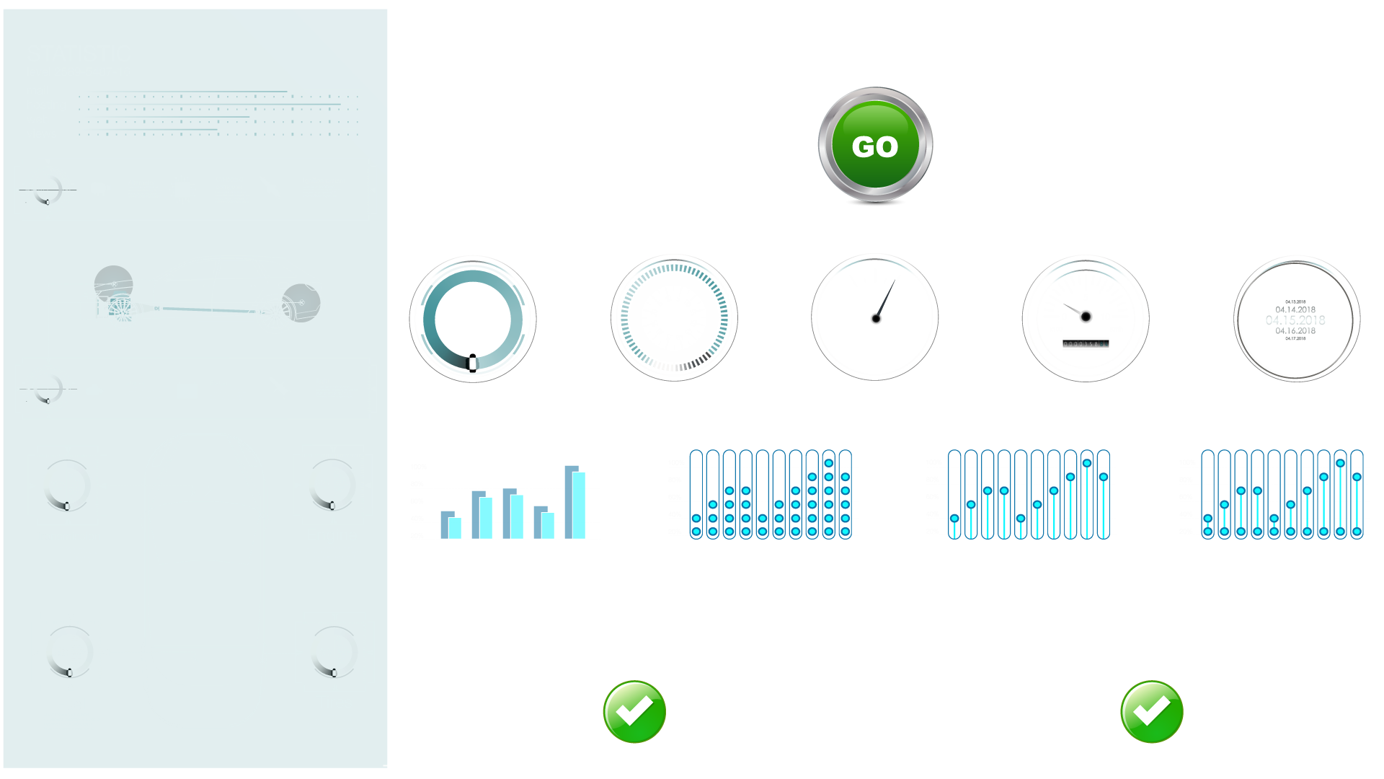

Slide 23
Outcomes
Improved lives with effortless experiences via human centered design thinking
Created an inhouse cloud based real time analytics and servicing platform
Enabled operational efficiency and built a scalable, resilient platform
Improved and more sustainable risk management
Empowered engineers, delighted auditors by integrating the platform with the automated real time release decisioning and governance engine

Slide 24

Testimonials
Backoffice Agent
Call Center agent
Senior Leadership
Business Analyst
My job is completely transformed ...no more excel sheets, notes
I can now focus more on servicing and meeting a customers need vs trying to juggle several systems. Huge relief
Big step in our tech. transformation journey and helping serve our customers better
Feel that we truly can start unlocking the power of data

Slide 25

High performers do good at throughput & stability
500 times
feature releases
3000 times
Infrastructure release
240x
Elite Performers:
2604 times faster
Elite Performers: 7 times lower
Deployment Frequency
Delivery Lead time
Mean Recovery Time
Change Failure Rate
2820 min. faster
2 times lower
Elite Performers: 208 times more
Elite Performers: 106 times faster

Slide 26
Key Learnings
Think BIG and BOLD!
Architect for scale and growth - iterative delivery
Power of agile - willingness to fail fast and small
Automation enables speed, productivity, stability and quality - No Fear Releases
Build a culture of acceptance and empowerment - blameless post mortems!
Enable monitoring to ensure continuous compliance to policy and controls
Never underestimate the challenges of the human change-curve with a radical technology transformation

Slide 27
What approach have others taken to address the challenges of the human change-curve during a significant technology transformation?
Looking for help!

Slide 28
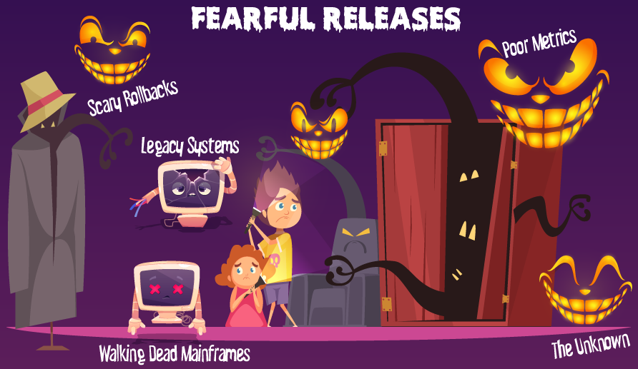
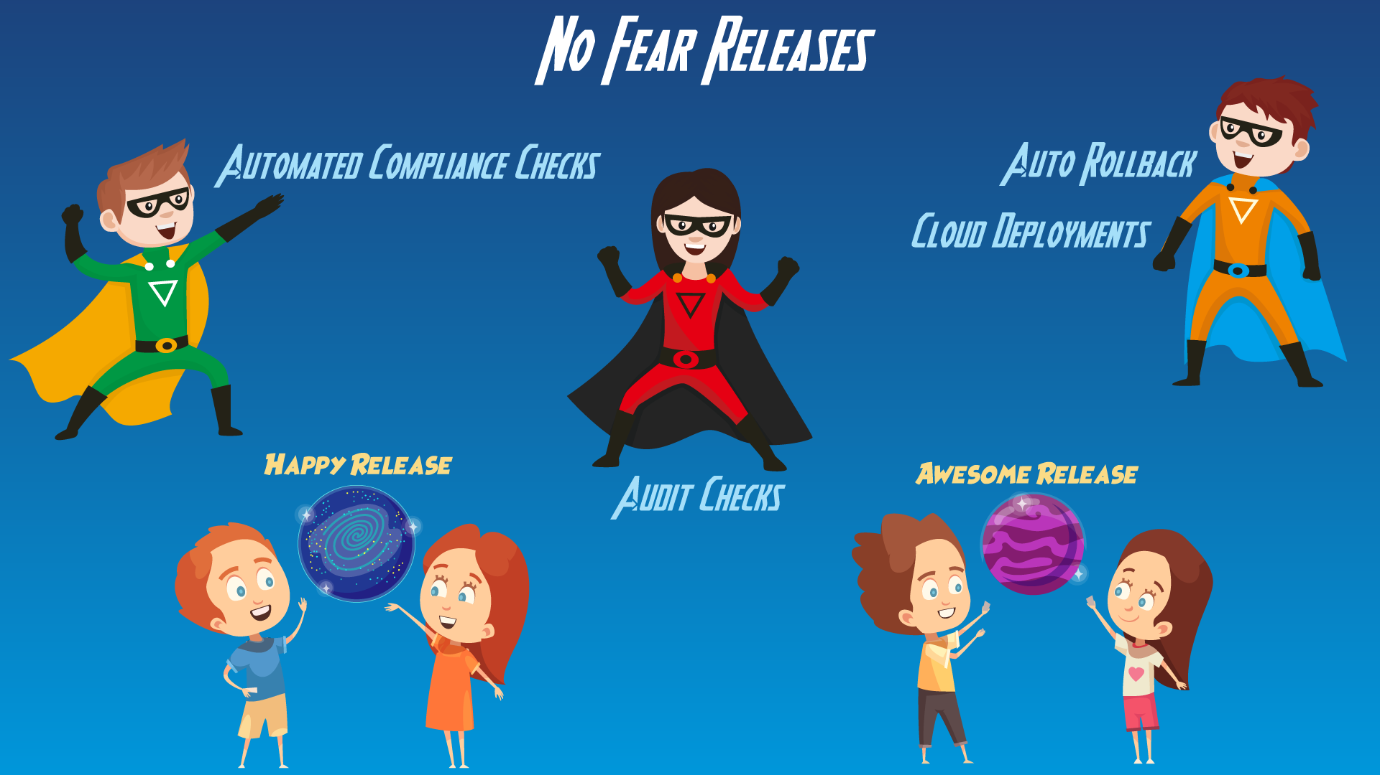
Contact us on the transformation and share your journey!
Rakesh Goyal
Jennifer Hansen
Biswanath Basu (Bose)

